Slide 1
From SAT to Satisfiability Modulo Theories (SMT)
Notes:
Paul dirac: “In science you want to say something that nobody knew before, in words which everyone can understand. In poetry you are bound to say... something that everybody knows already in words that nobody can understand.”
First-order theories is poetry in that sense.

Slide 2
Satisfiability
The classic SAT problem: given a propositional formula ϕ, is ϕ satisfiable ?
Example:
Let x₁,x₂ be propositional variables
Let ϕ := (x₁ → x₂) Æ (x₁ Æ :: x₂)
Is ϕ satisfiable ?

Slide 3
Satisfiability Modulo Theories
Now let the predicates be equalities
Example:
Let x₁,x₂,x₃ 2 Z
Let ϕ := ((x₁ = x₂) → (x₂ = x₃)) Æ x₁ ≠ x₃
Is ϕ satisfiable ?

Slide 4
Satisfiability Modulo Theories
Now let the predicates be from linear arithmetic
Example:
Let x₁,x₂,x₃ 2 R
Let ϕ := ((x₁ + 2x₃ < 5) Ç :(x₃ · 1) Æ (x₁ ¸ 3))
Is ϕ satisfiable ?

Slide 5
Satisfiability Modulo Theories
Now let the predicates represent arrays
Example:
Let i,j,a[] 2 Z
Let ϕ := (i = j Æ a[j] = 1) Æ a[i] ≠ 1
Is ϕ satisfiable ?

Slide 6
Generalization
Equalities, linear predicates, arrays, ...
Is there a general framework to define them ?
Yes ! It is called first-order logic
Each of the above examples is a first-order theory.

Slide 7
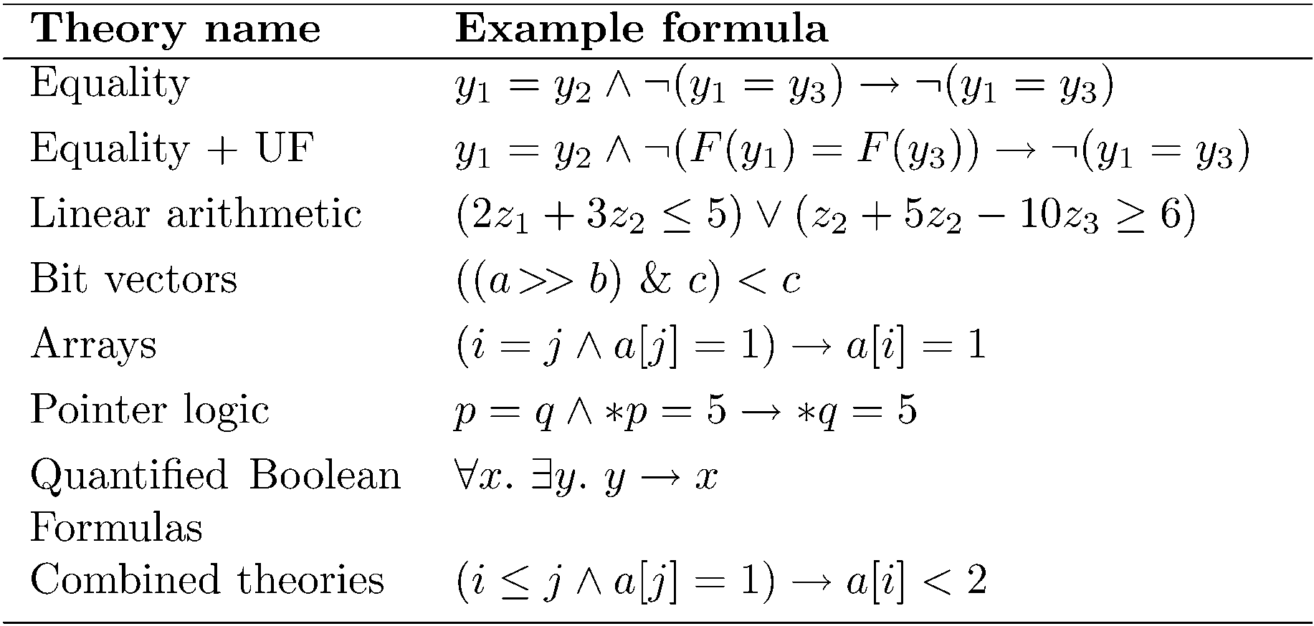
Some useful first-order theories
The SMT web page: https://smtlib.cs.uiowa.edu/

Slide 8
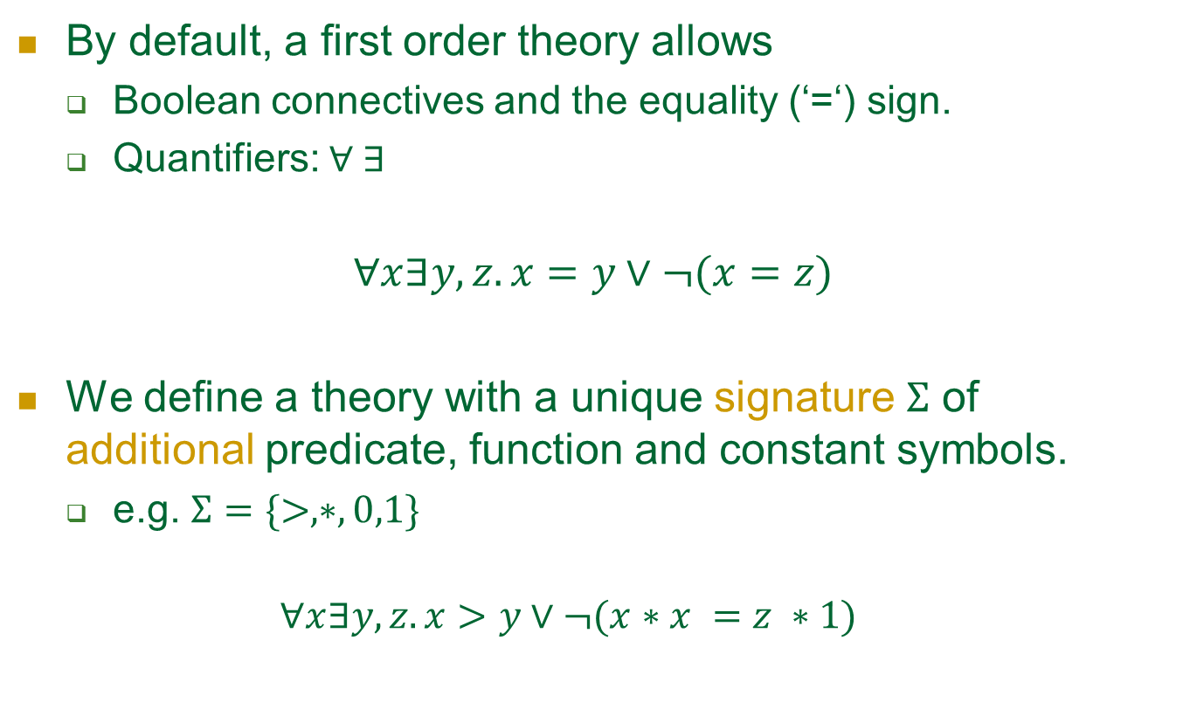
First order theory
By default, a first order theory allows
Boolean connectives and the equality (‘=‘) sign.
Quantifiers: $∀ ∃$
$$∀x∃y,z. x=y∨¬(x=z)$$
We define a theory with a unique signature $Σ$ of additional predicate, function and constant symbols.
e.g. $Σ=\{>,∗,0,1\}$
$$∀x∃y,z. x>y∨¬(x∗x =z ∗1)$$

Slide 9
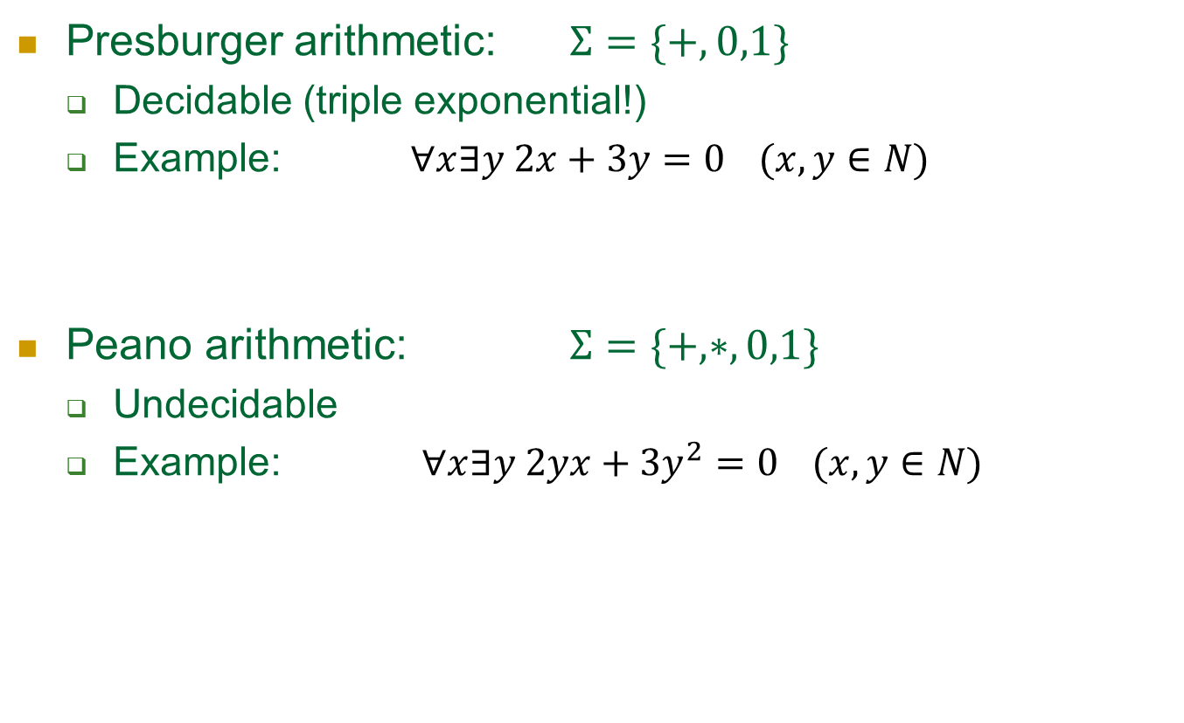
A tradeoff between expressibility and decidability
Presburger arithmetic: $Σ=\{+,0,1\}$
Decidable (triple exponential!)
Example: $∀x∃y 2x+3y=0$ $(x,y∈N)$
Peano arithmetic: $Σ=\{+,∗,0,1\}$
Undecidable
Example: $∀x∃y 2yx+3y^{2}=0$ $(x,y∈N)$

Slide 10
Tradeoff: expressiveness/computational hardness.
Assume we are given theories L₁ Á … Á L_{n}
Computational
Challenge!
L₁
L_{n}
Easier to decide
More expressive
Tractable
(polynomial)
Intractable
(exponential)
Decidable
Undecidable

Slide 11
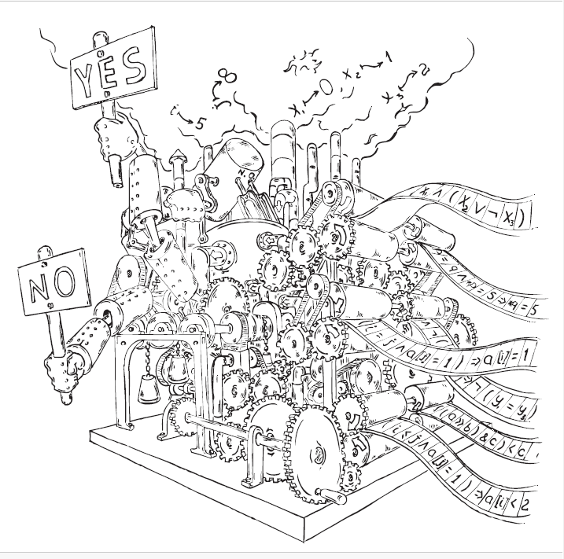
Decision procedures are beautifully complex…

Slide 12
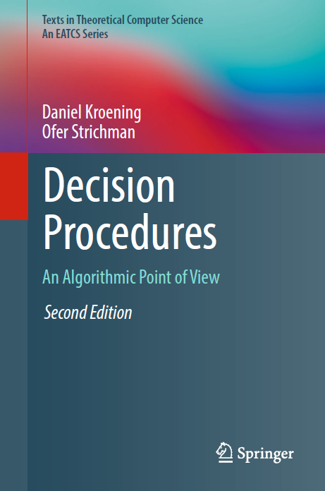



The Chinese translation
will be published early next year.

